Slide 1

Who’s Asking? Participatory Action Research, Interviewer Bias, and the Production of Knowledge in Prison
Kevin A. Wright, PhD
Arizona State University

Slide 2
Does it matter who is asking the question in prison research?

Slide 3
Participatory Action Research (PAR)
Power sharing
Empowered participation
Action
…with coresearchers
“Enabling people in prison to participate in research design (including defining measurements and collecting data) can enhance findings and yield positive change by making reforms more accurate, credible, and useful.”
Farrell et al., with Fine (2021:6)
Participatory Research in Prisons
Urban Institute

Slide 4
Center for Correctional Solutions PAR in Arizona
2 Projects (2017, 2020)
Reducing Recidivism
Enhancing the Prison Environment
Medium Security Men’s Prison
6 Trained Interviewers
Nearly 800 interviews completed
Haverkate et al. (2017)
On PAR with the Yard: Participatory Action Research to Advance Knowledge in Corrections
Corrections: Policy, Practice, and Research, 5(1), 28-43

Slide 5
“We believe answers are more honest when asked by fellow prisoners as opposed to a university researcher…Prisoners, oftentimes, portray a front to people they do not know. Our research showed 12% were homeless/couch-to-couch prior to their incarceration. If research was completed by the university researchers, we believe the numbers would be artificially less than what we found.”
Thrasher et al. (2019:20)
Reimagining Prison Research from the Inside-Out
Journal of Prisoners on Prisons, 28(1), 12-28.

Slide 6
“The fact that we were interviewed by fellow prisoners made it much easier to be completely honest. The interviewers spoke our language…The interviewers allowed me trust that my answers would be to “our” benefit as prisoners and not to “our” detriment.”
Shaun, as quoted in Thrasher et al. (2019:23)

Slide 7
Nagging Issues
Are we creating new knowledge?
Are we missing ethical concerns in taking this approach?
Does it matter who is asking the question in prison research?

Slide 8
Research Questions
Are we creating new knowledge?
Do responses to trust questions vary by interviewer type?
Do responses to open-ended questions on the prison experience vary by interviewer type?
Are we missing ethical concerns in taking this approach?
Do responses to comfort level of interview vary by interviewer type?

Slide 9
 | ASU (n = 80) | Incarcerated (n = 78)
Age | 39.31 (11.08) | 41.59 (12.32)
Children | 2.45 (1.74) | 2.58 (1.76)
Children < 18 years | 1.39 (1.55) | 1.36 (1.39)
Times to prison | 1.76 (1.22) | 2.13 (2.43)
Years incarcerated | 5.59 (6.72) | 5.41 (5.81)
Longest time incarcerated | 6.46 (6.40) | 6.88 (5.81)
White | 39% | 46%
Black | 6% | 4%
Hispanic | 29% | 32%
Other | 27% | 18%
Single | 42% | 54%
First time in prison | 62% | 56%
More than high school | 48% | 67%

Slide 10
Do responses to trust questions vary by interviewer type?
15 True/False questions on what trust means on the unit
14 Never – Always questions on involvement with other women
You can’t talk to women on this unit about personal matters without being judged
Response | False | True
Interviewer
ASU | 24 (33%) | 48 (67%)
Incarcerated | 35 (47%) | 39 (53%)
χ² = 2.96, p = .086

Slide 11
Do responses to open-ended questions vary by interviewer type?
 | ASU (n = 80) | Incarcerated (n = 78)
Tell me something about yourself or your life you are proud of.
Personal Growth and Resilience | 72% | 51%
What is your favorite way to pass your time in here and why?
Self-Betterment & Productivity | 74% | 53%
Tell me about your best experience with a member of staff
None/Negative | 26% | 8%
What is the difference between an ordinary day and a great day?
Positive Environment/Tolerable Conditions | 75% | 42%

Slide 12
Do responses to comfort level of interview vary by interviewer type?
Would you have been more comfortable completing this interview with [someone incarcerated at Cruz OR an ASU researcher]?

Slide 13
Do responses to comfort level of interview vary by interviewer type?
Response | Doesn’t Matter | Would NOT Be More Comfortable
Interviewer
ASU | 21 (26%) | 59 (74%)
Incarcerated | 49 (63%) | 29 (37%)
χ² = 21.40, p < .001

Slide 14
Talked to ASU, Preferred ASU
They are not legitimate; They will share the information and antagonize
Do not trust incarcerated women at Santa Cruz
“They are like me"; higher respect for someone from ASU
Fear or apprehension that answers will be discussed elsewhere
I would've thought it was fake
Because they judge you (incarcerated women); easy to be honest with someone that she doesn't know

Slide 15
Talked to Cruz, Preferred Cruz
More comfortable with someone in orange that can relate
Because my interviewer is an inmate & we have shared experiences, understand what it's like, an ASU person wouldn't care
I feel like with inmates you can be more open with what happens inside of here
Easier to talk to incarcerated women who understand
Because I would be more comfortable with an inmate because I feel like an ASU researcher will be judgmental

Slide 16
Research Questions
Are we creating new knowledge?
Do responses to trust questions vary by interviewer type?
No
Do responses to open-ended questions on the prison experience vary by interviewer type?
No, with a few exceptions
Are we missing ethical concerns in taking this approach?
Do responses to comfort level of interview vary by interviewer type?
Yes

Slide 17
Challenges and Implications
Sample size and composition
Context matters
Identity
Topic
Our work ahead…

Slide 18
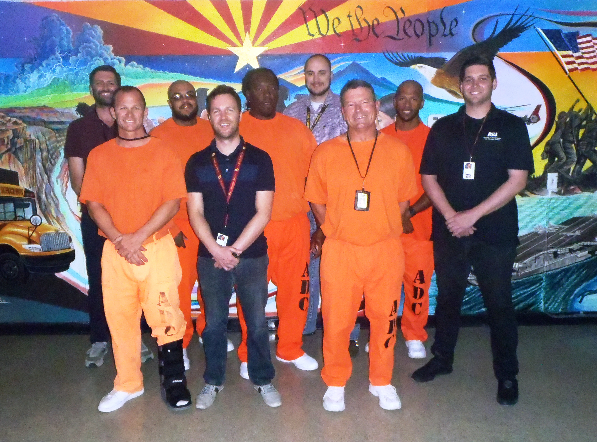
“We strongly recommend that, if given the opportunity, every prisoner should experience the unfamiliar sensations and thought processes that come along with conducting meaningful research. For us, there exists a newfound motivation to be involved and make a difference.”
Thrasher et al. (2019:16)
Reimagining Prison Research from the Inside-Out
Journal of Prisoners on Prisons, 28(1), 12-28.

